Slide 1
Using Fluorescence Tools in the Field and in the Lab to Understand Tempe Town Lake’s Biogeochemical Cycles
Elinor Sauer and Dr. Hilairy Hartnett
School of Earth and Space Exploration

Slide 2
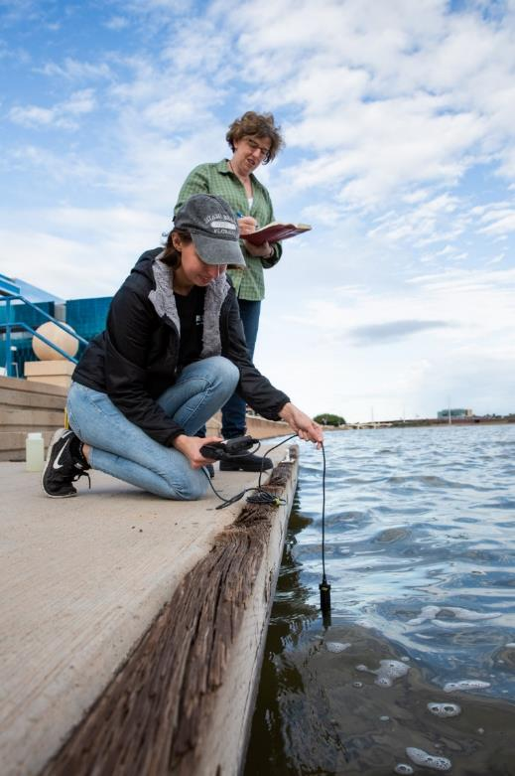
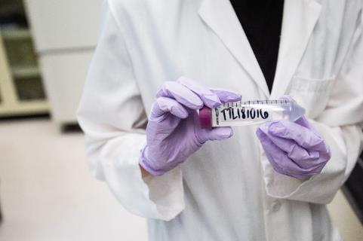

Introduction
Tempe Town Lake (TTL)
Things I Measure:
pH
Dissolved Oxygen
Conductivity
Dissolved Organic Carbon
UV and Fluorescence
The Hartnett lab has monitored TTL water chemistry and dissolved carbon since 2005
For the past year, I have sampled TTL twice a week
A new DataSONDE has also been collecting in situ data for one year
My project compares lab results with in situ data from the SONDE
A filtered TTL sample ready for fluorescence analysis
Elinor Sauer and Dr. Hartnett gathering data at TTL

Slide 3
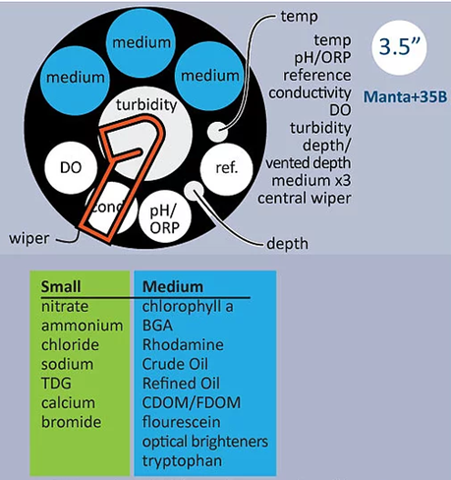
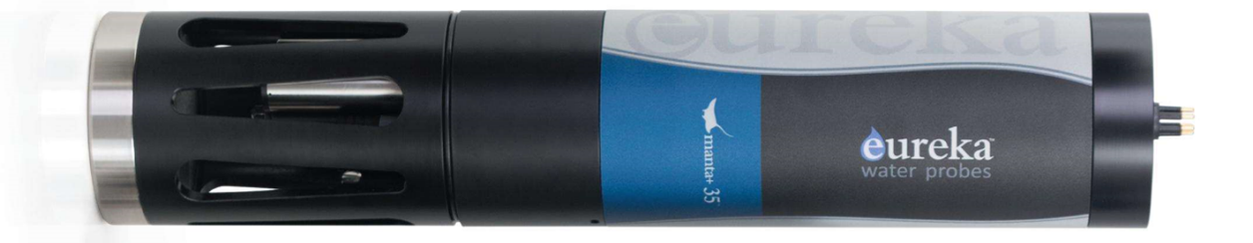


Background
SONDE
Background
Data SONDE
The SONDE measures pH, Dissolved Oxygen, Conductivity, and fluorescent Dissolved Organic Carbon
  the same parameters I measure each week
Collects data every 30 minutes
Monthly data retrieval and SONDE maintenance

Slide 4
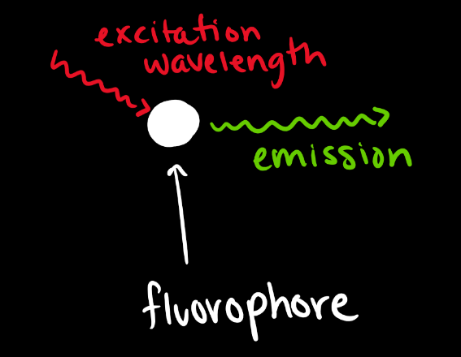
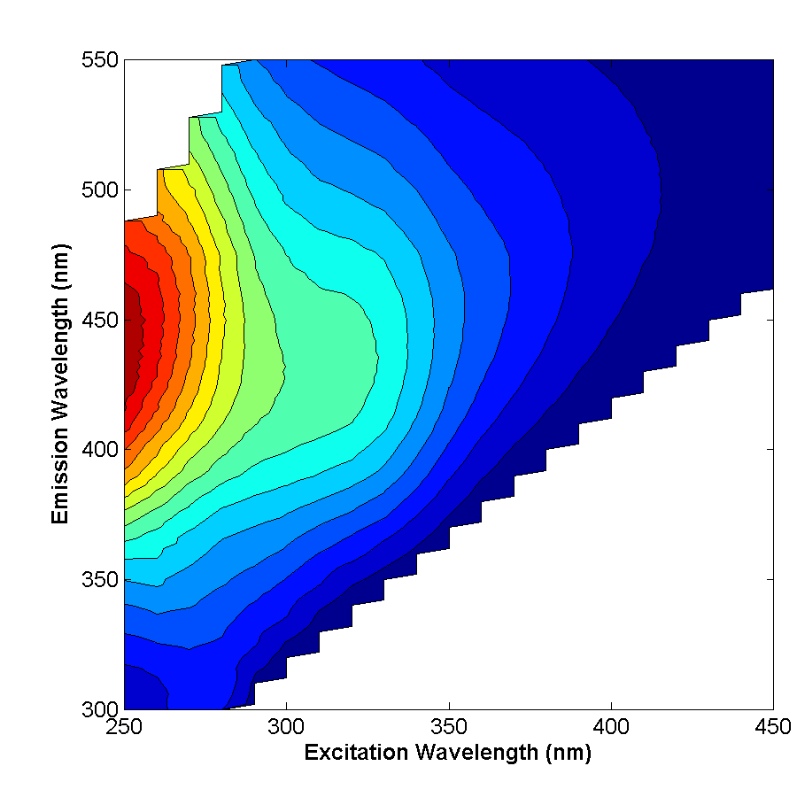

Background
Fluorescence
Background
Fluorescence
Fluorophores are molecules that can be excited by a certain wavelength and emit a longer wavelength
The difference in excitation and emission spectra can be used to distinguish different molecules within a sample
In the lab we test across the spectrum of wave lengths, producing 3D graphs
The SONDE only measures at a specific wavelength

Slide 5
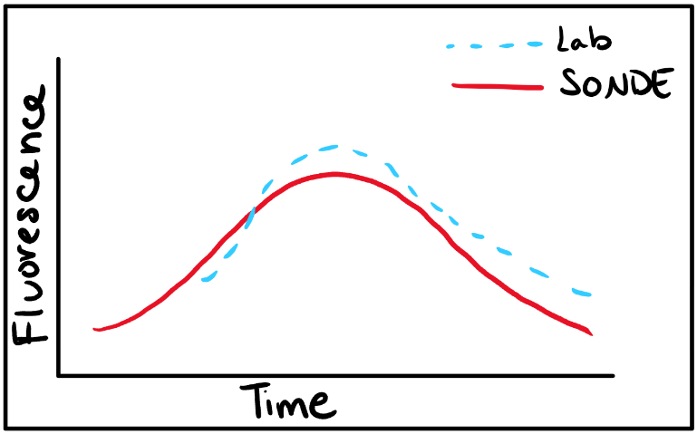
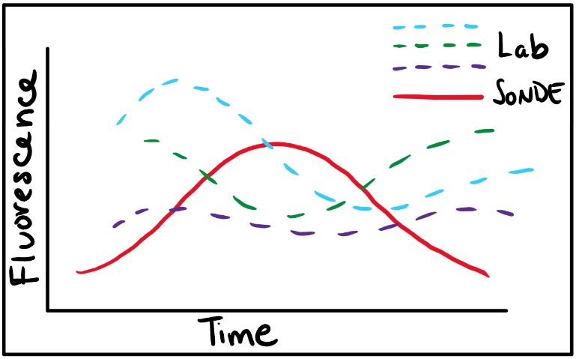
The Question
The Big Question
Is the SONDE data consistent with the lab measurements?
If they are not, I expect differences between the lab data and the SONDE data:
If they are, I expect to see something like:

Slide 6
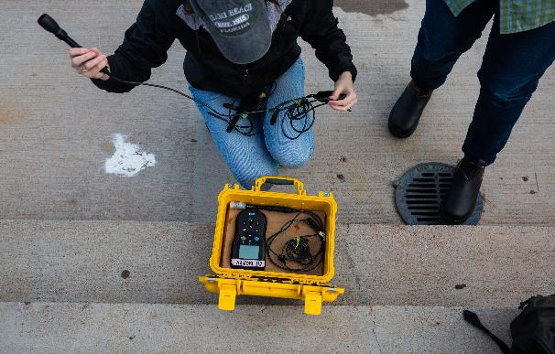
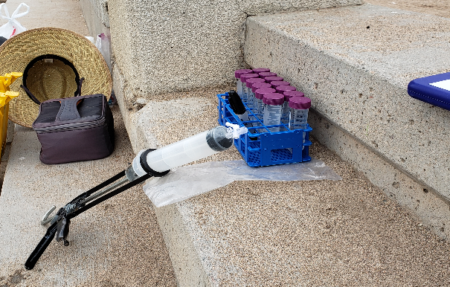
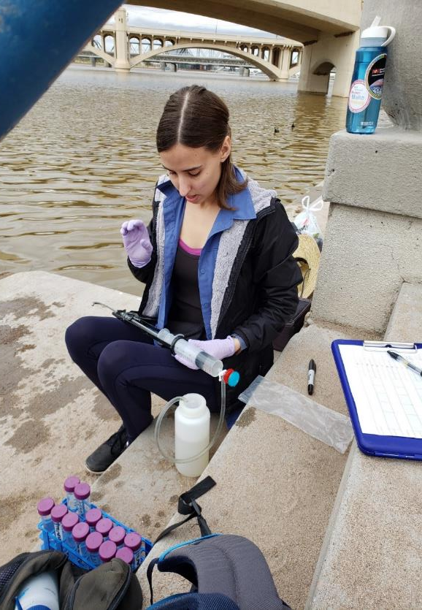
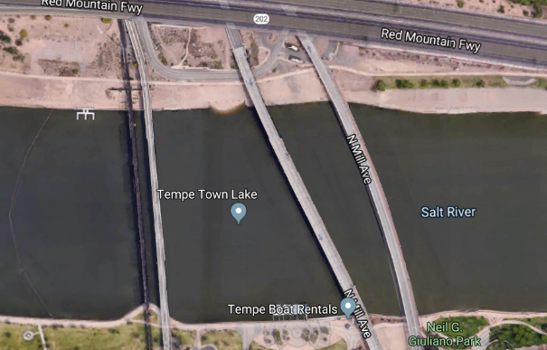


Methods
Methods
dataSONDE/Lab comparison study
Collect samples every 30 minutes
Measure fluorescence and water chemistry
Compare with dataSONDE!

Slide 7
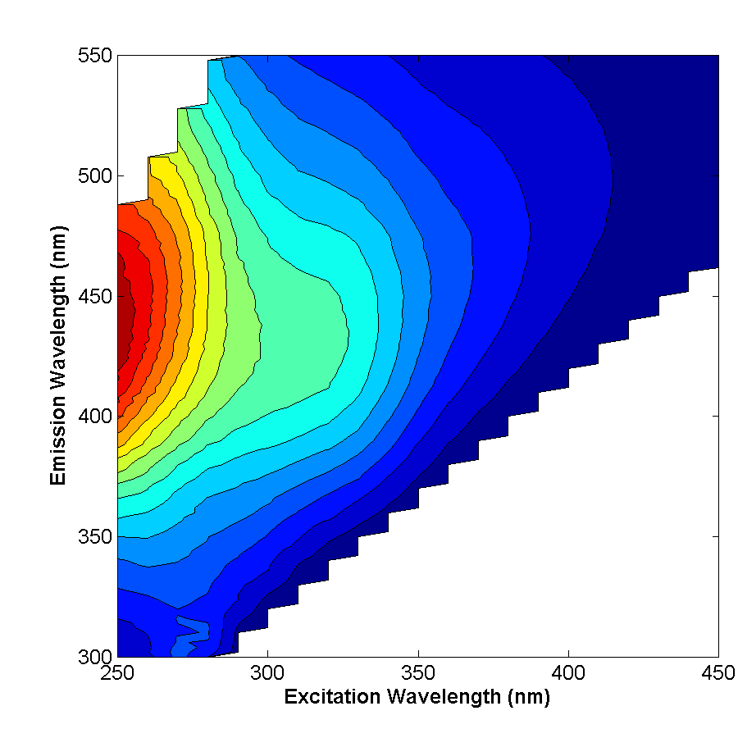
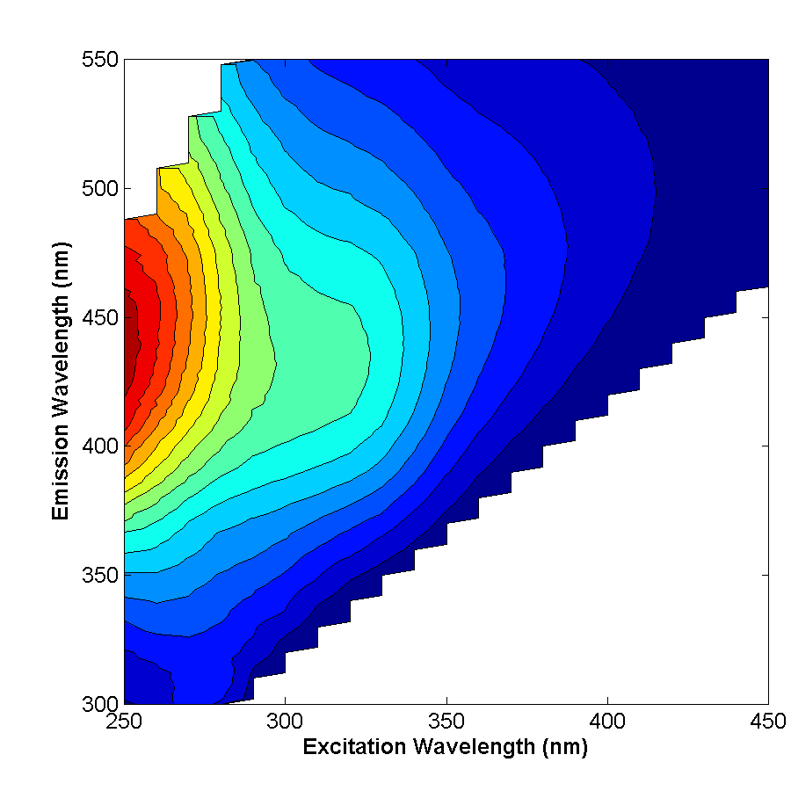

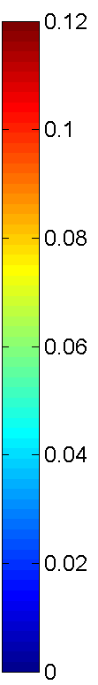

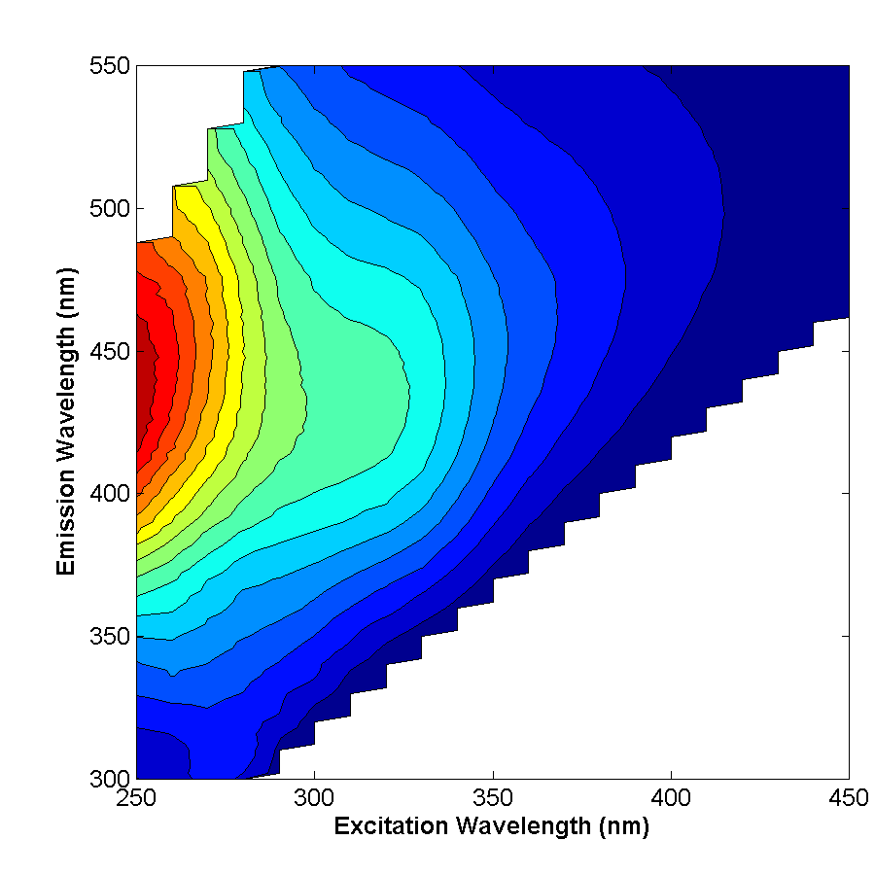

Data
Fluorescence from Lab
Data
Fluorescence from Lab
9:00 AM
9:43 AM
10:32 AM
11:00 AM
Fluorescence Intensity (relative units)
Fluorescent components are derived from a PARAFAC model (Cory and McKnight, 2005)
11:30 AM
12:16 PM
12:50 PM

Slide 8
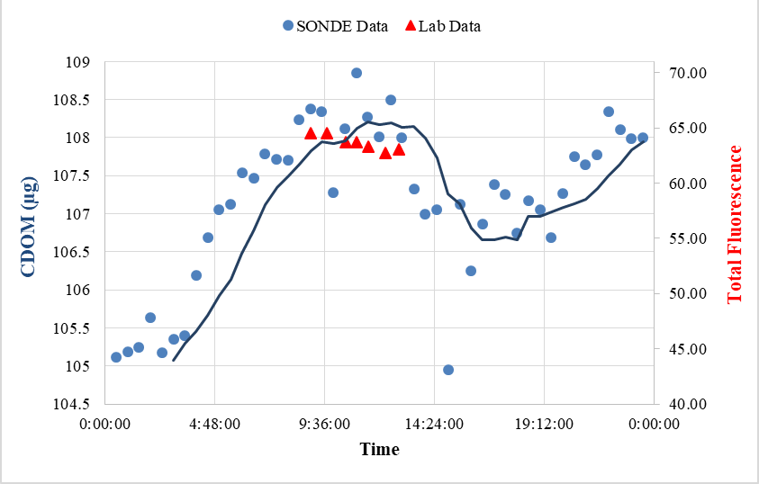
Data
Fluorescence from Lab
Data Comparison
SONDE data and Total fluorescence
Total Fluorescence is the sum of all the intensity in the EEM
Scale is not the same, but the pattern basically is

Slide 9
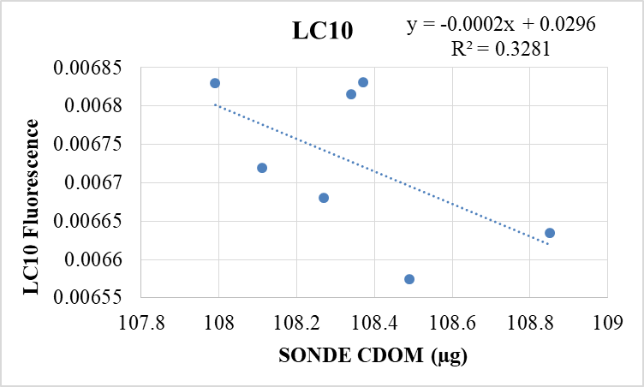
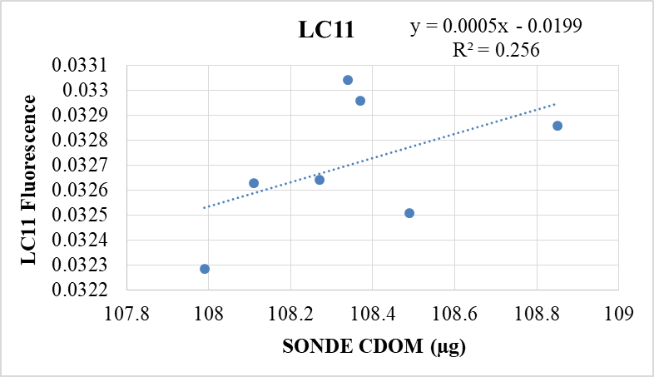
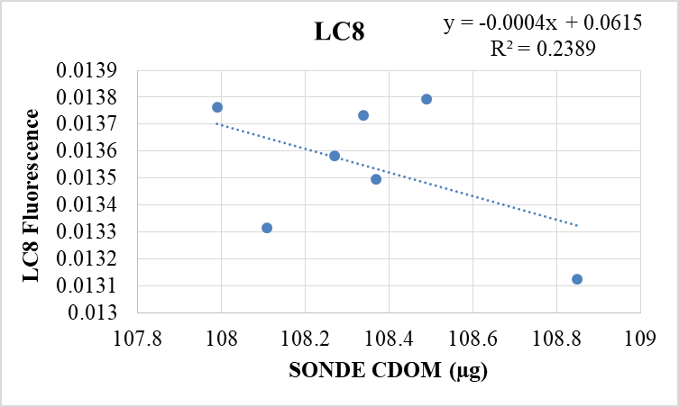
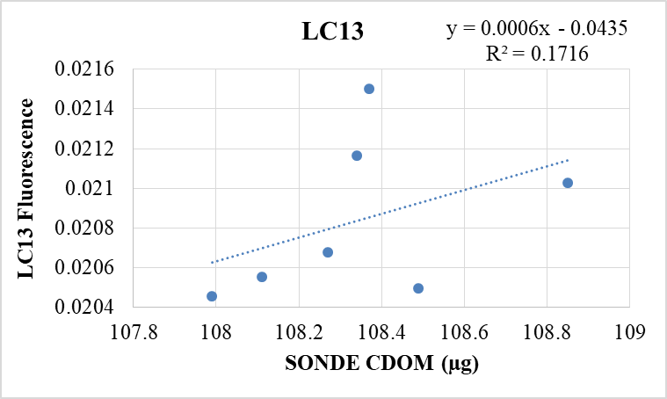


Data
Fluorescence from Lab
Data Comparison
SONDE data vs Individual Components
Of the thirteen components, these four had the strongest relationship to the SONDE data
R² is still understandably small, due to the limited sample size
These may indicate both positive and negative relationships between components and SONDE data

Slide 10
Data
Fluorescence from Lab
Conclusions, Implications, and Future Plans
  Total Fluorescence and SONDE CDOM patterns are consistent
      CDOM is a good proxy for fluorescent carbon
  Relationships, both positive and negative, between the SONDE and certain components are evident in the comparison
    These could have bigger implications for the applicability of the SONDE
New questions:
  Do these pattern hold true over the other parts of the day?
  Do CDOM and total Fluorescence reflect carbon concentration?
Next steps:
Do the field experiment again at different times of day
Measure total carbon concentrations using DOC
Thank you to Josh Nye for help with the modelling, Tessa Fisher for SONDE data and Donald Glaser for sampling assistance!

